Slide 1
DIGITAL PORTFOLIO
STUDENT NAME: PRAVEEN KUMAR S
REGISTER NO AND NMID: 2428C0499 & 33164B38BBEDB2395AB44D628A8C1A9F
DEPARTMENT: II BSc AIML
COLLEGE: KPR COLLEGE OF ARTS SCIENCE AND RESEARCH / BHARATHIAR UNIVERSITY

Slide 2

PROJECT TITLE
DIGITAL SHOWCASE

Slide 3


AGENDA
Problem Statement
Project Overview
End Users
Tools and Technologies
Portfolio design and Layout
Features and Functionality
Results and Screenshots
Conclusion
Github Link
3/21/2024 Annual Review

Slide 4
PROBLEM STATEMENT
In the competitive and rapidly evolving music industry, musicians and singers often struggle to showcase their talent, achievements, and unique artistic identity to potential fans, collaborators, agents, and event organizers. Traditional methods such as physical portfolios, scattered social media accounts, or word-of-mouth promotion lack cohesion, professionalism, and reach.

Slide 5

PROJECT OVERVIEW
The Musician/Singer Portfolio project is aimed at creating a professional online presence for a singer or musician to showcase their talent, achievements, and artistic identity. This digital portfolio will serve as a central hub where visitors can explore the artist’s biography, discography, live performances, media features, and upcoming events. It will include audio and video samples, a photo gallery, and links to social media and streaming platforms for greater audience reach. A responsive and visually engaging design will ensure accessibility across all devices. The site will also feature a contact section for bookings and collaborations, enhancing professional opportunities. By consolidating all relevant content in one place, the portfolio boosts credibility and makes it easier for fans, agents, and event organizers to connect with the artist. The project combines creative presentation with functional design to reflect the artist’s unique brand.

Slide 6

WHO ARE THE END USERS?
Students
Showcase academic projects, internships, and extracurricular achievements.
Include a resume section highlighting education and skills.
Job Seekers
Present professional experience, certifications, and key projects.
Upload resumes and cover letters for easy sharing with employers.
Freelancers
Display completed client projects and portfolios of work.
Highlight skills, testimonials, and contact information for new opportunities.
Professionals
Showcase career achievements, ongoing work, and professional development.
Share detailed case studies, publications, and a resume for networking.

Slide 7

TOOLS AND TECHNIQUES
HTML→ Structure( pages, sections).
CSS→ Styling (colors, layout, responsiveness).
JAVA SCRIPT→ Interactivity (navigation menu , animations, form validation).
Code editor VS code and hosting platform Github.

Slide 8
PORTFOLIO DESIGN AND LAYOUT
Portfolio Design and Layout (Point View)
Clean, modern, and visually appealing design tailored to the artist's style
Responsive layout for seamless viewing on all devices (desktop, tablet, mobile)
Hero image or video on homepage with artist’s name/logo and tagline
Sticky navigation bar for easy access to all sections
Dedicated sections for About, Music, Videos, Gallery, Events, Press, and Contact
Embedded audio and video from platforms like Spotify, YouTube, or SoundCloud
Event calendar to display upcoming shows with details and ticket links
Press/news section for media features, awards, and blog updates
Contact form for booking and collaboration inquiries
Consistent color palette, typography, and interactive design elements for brand identity
8

Slide 9
FEATURES AND FUNCTIONALITY
The Musician/Singer Portfolio includes key features such as a biography section, photo and video gallery, embedded audio tracks, discography showcase, event calendar for upcoming performances, and a blog or news section for updates. It integrates social media and streaming platforms for broader reach and fan engagement. A contact form enables booking and collaboration inquiries, while responsive design ensures accessibility on all devices. These functions collectively create a professional and interactive online presence for showcasing talent and building a music career.

Slide 10

GITHUB LINK
https://github.com/praveenkumar-sys
3/21/2024 Annual Review
10

Slide 11
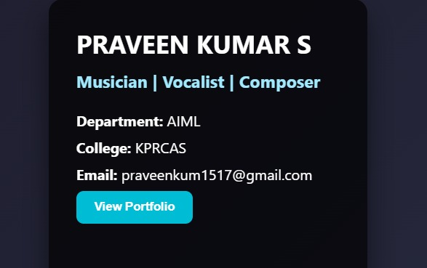
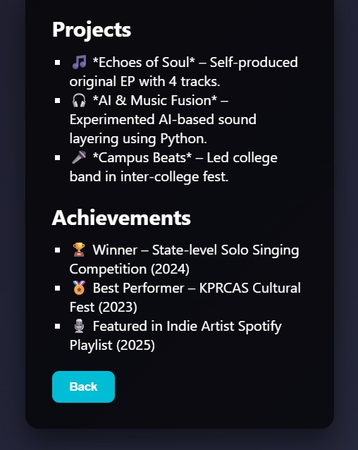
RESULTS AND SCREENSHOTS
3/21/2024 Annual Review
11

Slide 12
CONCLUSION
The Musician/Singer Portfolio is a powerful tool for building a strong digital presence in today’s competitive music industry. It serves as a professional showcase of the artist’s talent, personality, and achievements, all in one centralized and visually appealing platform. With features like integrated audio/video, event listings, media highlights, and a contact form, it enhances fan engagement, opens up collaboration opportunities, and helps artists connect with industry professionals. A well-designed portfolio not only reflects the artist’s brand but also plays a crucial role in career growth and visibility.
12

